Slide 1





Tech Days 2021 Flight into IoT
Clifford Agius
IoT Solutions Expert / Airline Pilot
CA Software Ltd
Azure MVP
@cliffordagius

Slide 2

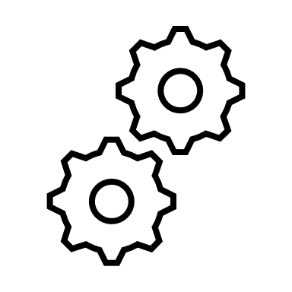







Flight into IoT System Diagram
Service Bus Queue
Logic
App
3rd Party Services
IoT Hub
Time Series Insights
Device Provisioning Service
Stream Analytics
Power BI

Slide 3
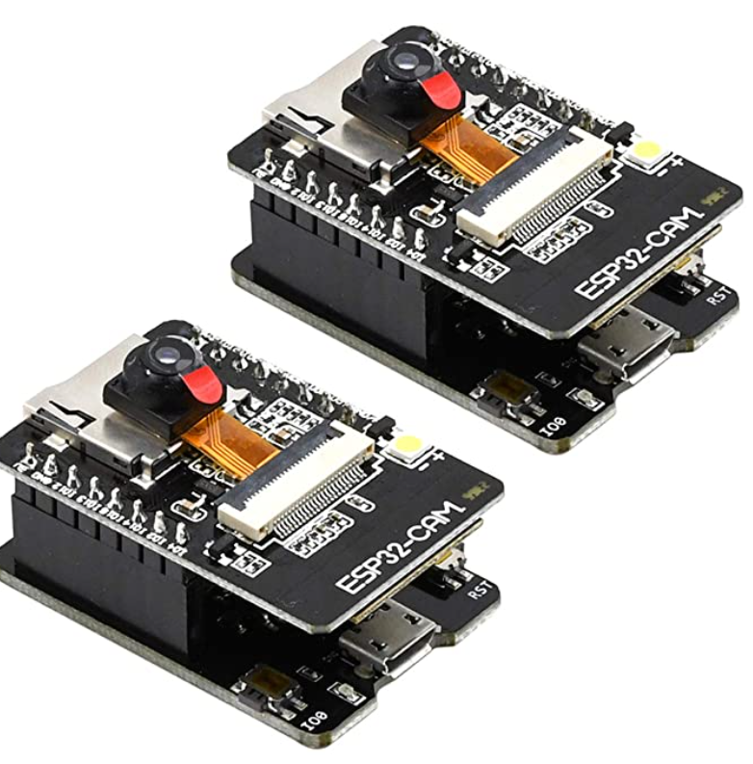
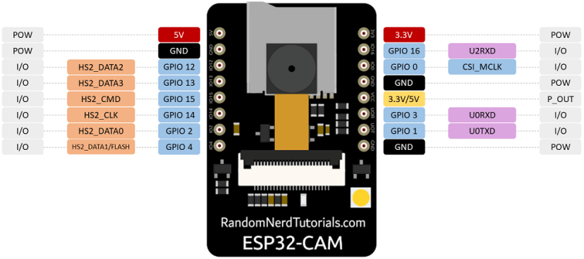
Flight into IoT System Device
FEATURES
Up to 160MHz clock speed，Summary computing power up to 600 DMIPS
Built-in 520 KB SRAM, external 4MPSRAM
Supports UART/SPI/I2C/PWM/ADC/DAC
Support OV2640 and OV7670 cameras, Built-in Flash lamp.
Support TF card
Supports multiple sleep modes.

Slide 4
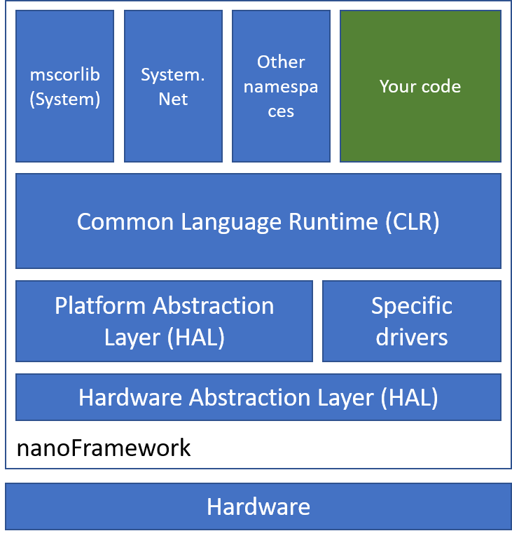
Flight into IoT System Device
The .NET nanoFramework platform picks up where .NET Micro Framework left off and uses some of its building blocks.
Many of the original components were completely rewritten
Uses a reduced version of the .NET Common Language Runtime (CLR) and features a subset of the .NET base class libraries.
Currently there are reference targets ready to use for ARM Cortex-M SoC and ESP32

Slide 5
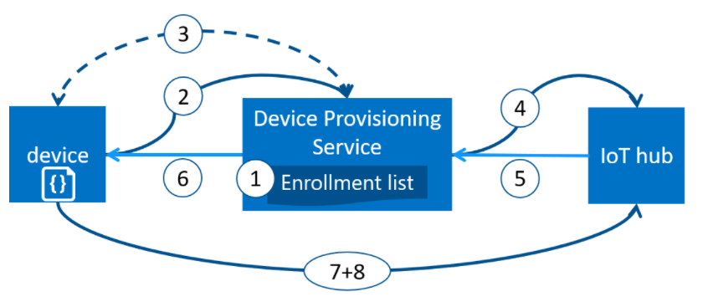

Flight into IoT System Device
Notes:
Device manufacturer adds the device registration information to the enrollment list in the Azure portal.
Device contacts the DPS endpoint set at the factory. The device passes the identifying information to DPS to prove its identity.
DPS validates the identity of the device by validating the registration ID and key against the enrollment list entry using either a nonce challenge (Trusted Platform Module) or standard X.509 verification (X.509).
DPS registers the device with an IoT hub and populates the device's desired twin state.
The IoT hub returns device ID information to DPS.
DPS returns the IoT hub connection information to the device. The device can now start sending data directly to the IoT hub.
The device connects to IoT hub.
The device gets the desired state from its device twin in IoT hub.

Slide 6
Demos
IoT Hub Creation and Device Simulation

Slide 7
Flight into IoT Useful Links
Azure IoT Device Provisioning Service Docs
https://docs.microsoft.com/azure/iot-dps/about-iot-dps
nanoFrameWork
https://www.nanoframework.net
Install and use Azure IoT explorer
https://docs.microsoft.com/azure/iot-fundamentals/howto-use-iot-explorer
Derive the device key
https://docs.microsoft.com/azure/iot-dps/how-to-legacy-device-symm-key
Cloud Skills Challenge
https://docs.microsoft.com/learn/challenges
GitHub Repo
https://github.com/CliffAgius/TechDays2021

Slide 8
Thankyou
Q&A
Clifford Agius
IoT Solutions Expert / Airline Pilot
CA Software Ltd
Azure MVP
@cliffordagius

